Slide 1
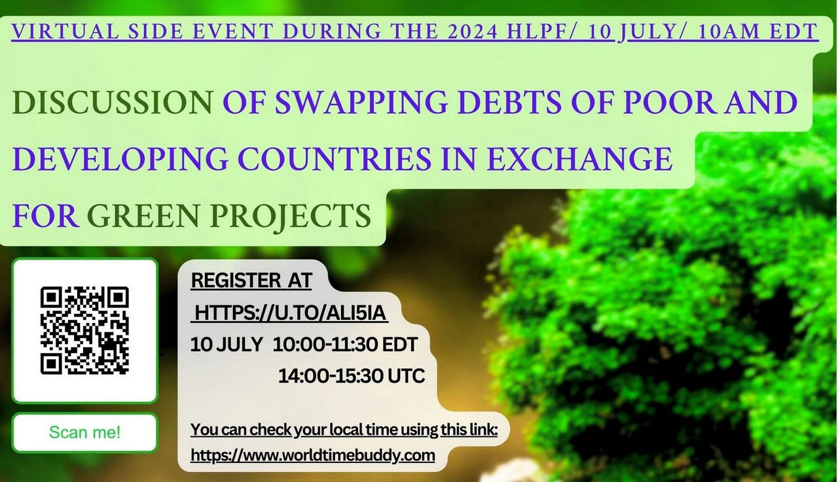

Slide 2
Virtual side event during the 2024 HLPF
Topic: "Discussion of swapping debts of poor and developing countries in exchange for green projects"
Date: 10 JULY Virtual side event 2024 HLPF
Time: 10AM EDT/ 14.00 UTC
Organizers: Public Foundation NASH VEK together with the External Aid Monitoring Group

Slide 3
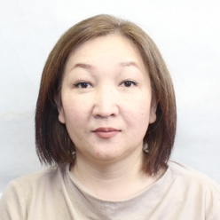
Chinara Aitbaeva
Director Public Foundation Nash Vek,
External Aid Monitoring Group

Slide 4
Middle-income countries are home to 75% of the world's population and 62% of the world's poor. At the same time, middle-income countries account for about a third of global GDP and are the main engines of global growth.
Developing countries are currently facing a critical debt situation. Debt servicing has increased by 50 percent over the past three years, widening the financing gap for development tasks.
Achieving significant advances in statistics, financing and policies for gender equality, and overall development in general, requires sufficient resources.
According to the OECD, poor and developing countries received more than $220 billion in Official Development Assistance last year. These recipient countries are currently facing debt repayment quandaries due to the global crisis.
It would be wise to encourage donor countries to initiate a full-scale debt swap in exchange for green projects that will have a positive impact on climate change.
During this side event, the issues of debt of poor and developing countries and the possibility of their debt for green projects will be discussed.
Instead of directing money to Development, poor and developing countries are paying off debts. We propose to discuss ways out of the debt crisis and propose specific Solutions.

Slide 5
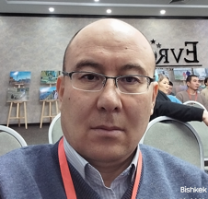
Alisher Moidunov
Main points of speech
Speaker
External Aid Monitoring Group Member
Data for African countries

Slide 6
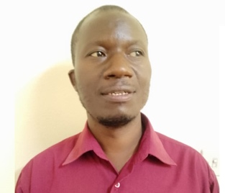
Never Mujere,
I am a researcher in climate change issues, have published work in the subject and presented papers at international conferences
Speaker
Environmental Mgt Trust
Zimbabwe
Main points of speech
Benefit sharing, win-win situations, Reasons for indebtedness in developing countries, exploitation of pristine environments in developing nations by the developed countries. Who will benefit from the swap.

Slide 7

Anna Rychkova,
Speaker
External Aid Monitoring Group Member
Data for Southeast and Central Asia

Slide 8
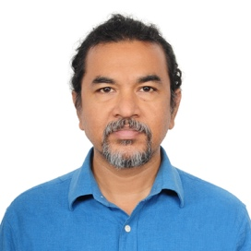
Barkat Ullah Maruf,
I have been working on this campaign at national and international platforms for the last 20 years. I have arranged and led many national and local level advocacy against debt and poverty in Bangladesh.
Speaker
COAST Foundation.
Main points of speech
Debt increases the poverty and obstructs national progress. Bangladeshe is forced to increase price of electricity, VAT and other indirect taxes, and are prescribed to implement environment-destructive projects.

Slide 9
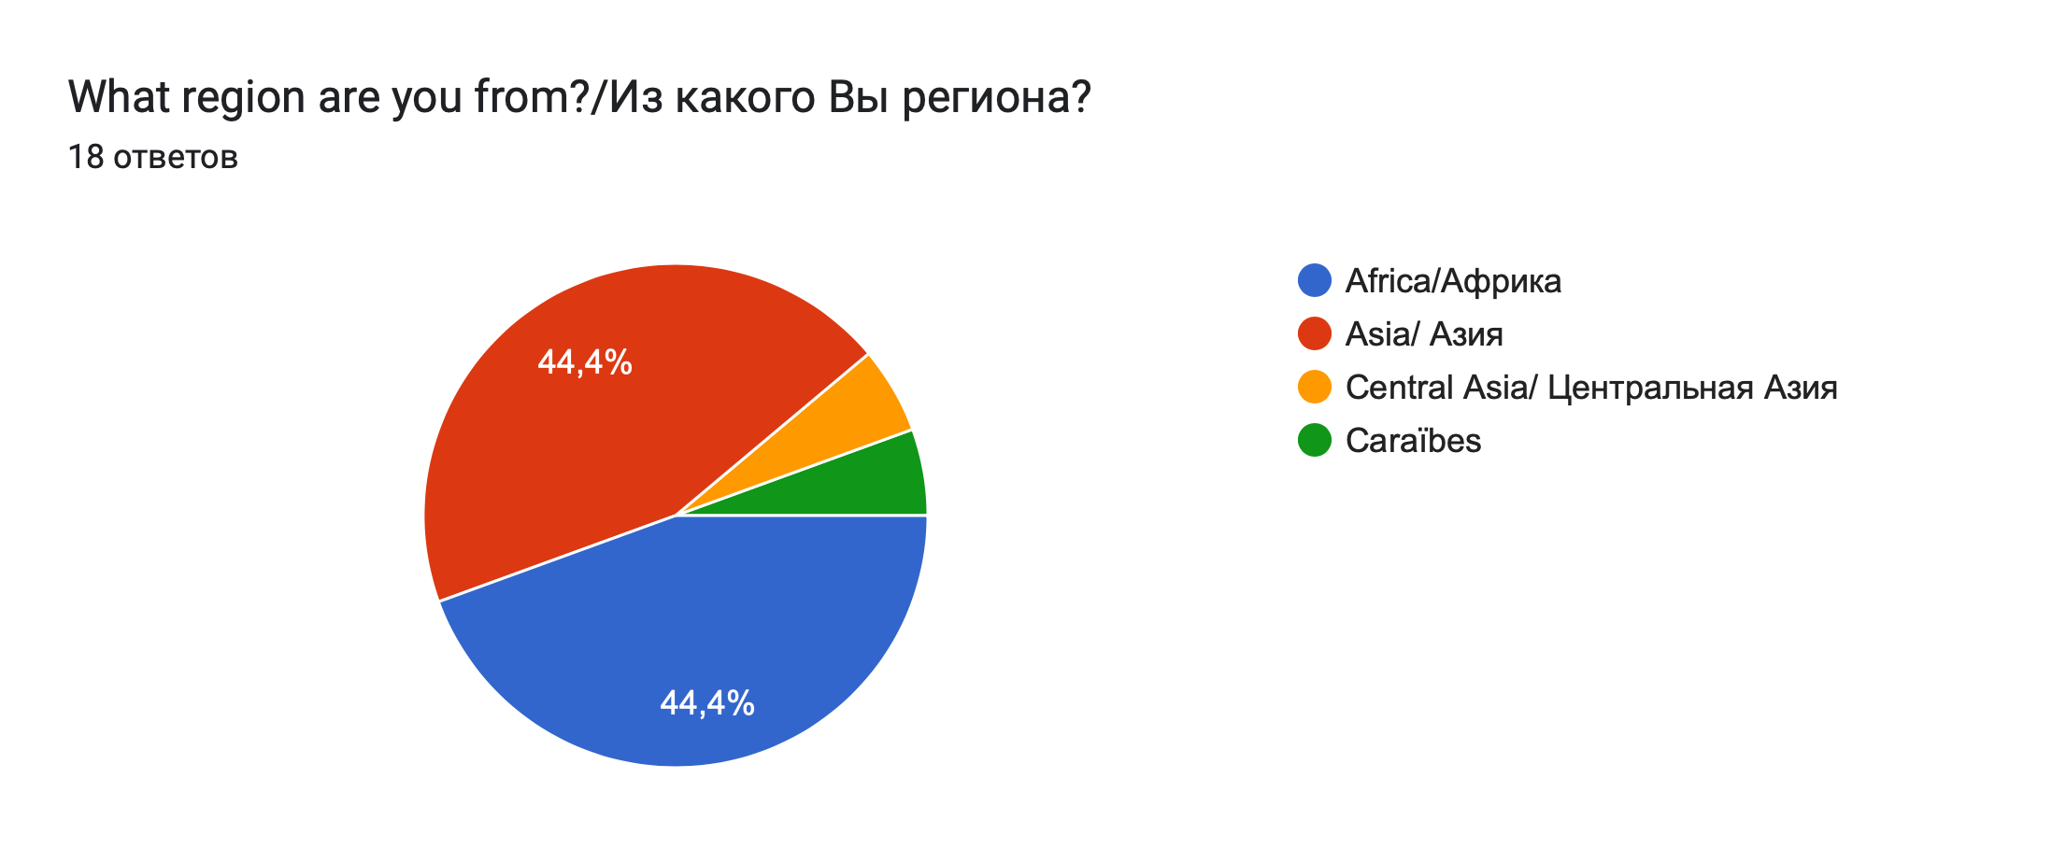
I thank everyone who responded to this topic.
18 people said they would like to act as a speaker on this topic

Slide 10
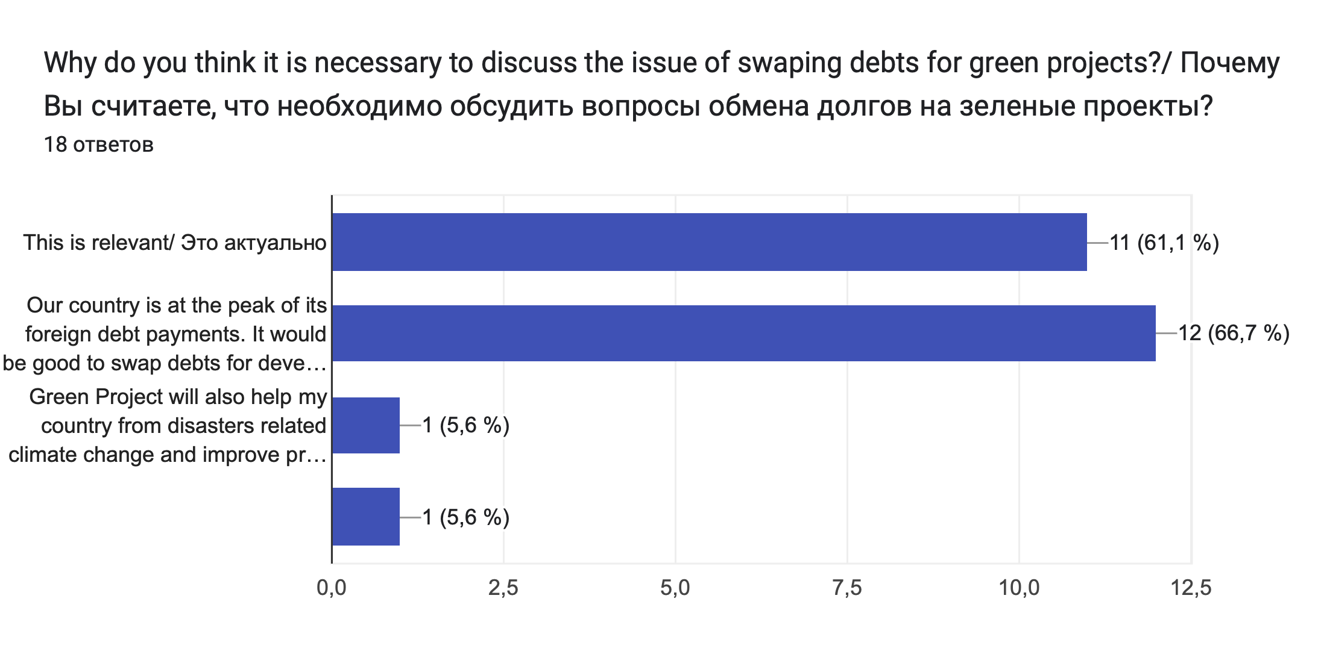
Most participants noted that this topic is relevant. And about 67% responded that their country is experiencing a peak in foreign debt payments.

Slide 11
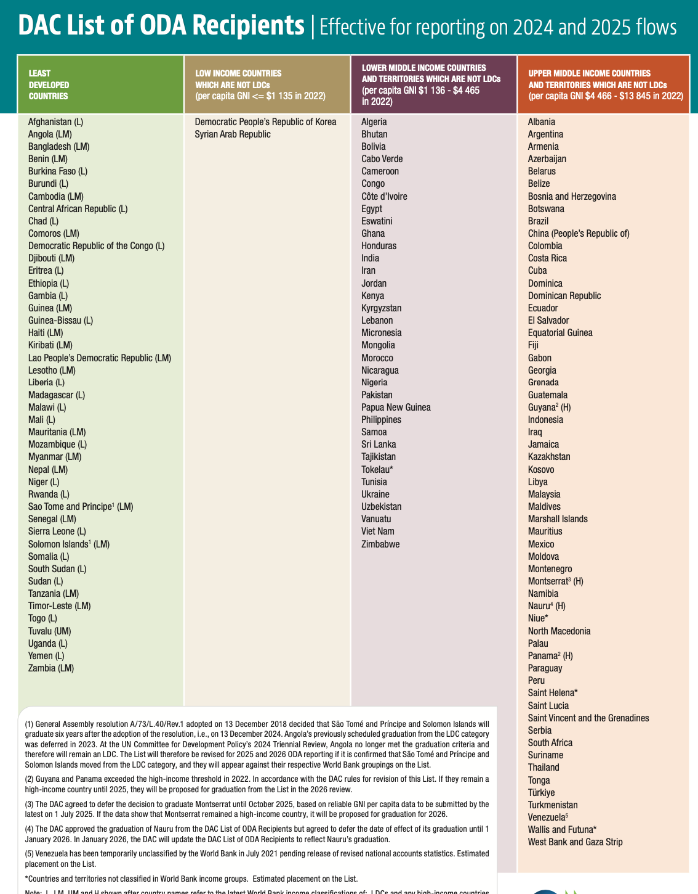
Least Developed Countries – 45
Low Income Countries – 2
Lower Middle Income Countries – 35
Upper Middle Income Countries - 59

Slide 12
According to the classification of the World Bank (219 countries)
High income – 87,
Low income – 25,
Lower middle income – 51,
Upper middle income – 56

Slide 13
About 70 countries are facing peak foreign debt payments. About 30%

Slide 14
All speakers will speak now.
I think everyone is participating here who shares the idea of ​​​​exchanging debt for green projects.
We may not support the actions of some country authorities in relation to civil society to shrinking space for CSOs. But, we support our countries. We want development for our countries. To ensure that no one is left behind, opportunities for Development must be provided.
Then, everyone will be given the opportunity to speak (maximum 3 minutes) to shape your ideas and recommendations for states, donors and CSOs.
Please answer the following questions when presenting.

Slide 15
Taking this opportunity, and due to limited time, I ask everyone to answer the following questions:
(Please also leave answers and comments to these questions in the chat)
What are your specific proposals and recommendations for donors and states to exchange debts for green projects?
What should civil society do to make debt swaps for green projects effective?

Slide 16
Thank you!

